Slide 1
Operation Aurora
USA - China, June-Dec 2009
Bofin Babu
2013H313085H

Slide 2
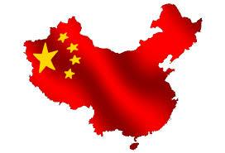
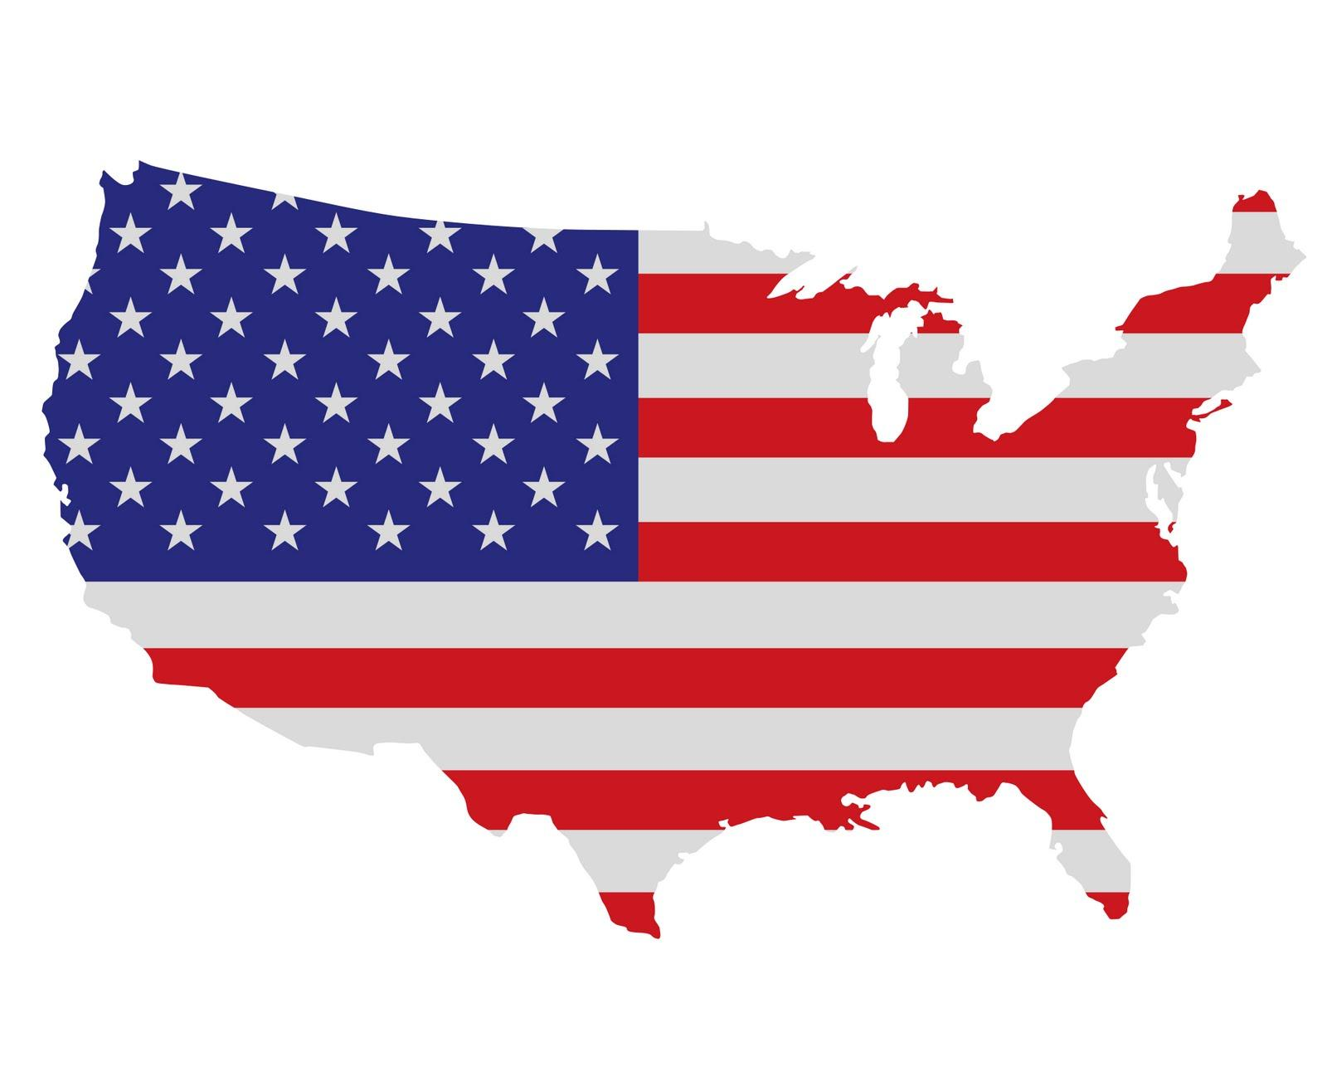
Originated from China, targeted American corporates
China
PLA Unit 61398 (Under Communist party of China)
Elderwood Group
USA
Google, Adobe, Juniper
Rackspace, Yahoo,
Morgan Stanley, Symantec,
Northrop Grumman and Dow Chemical and more

Slide 3
History
Happened between June - December 2009.
Revealed by Google on January 12, 2010, in a blog post.
According to media reports 34 companies including Google were victims.
Mainly targeted Google, resulted in the theft of some of their source code.
An anonymous Chinese official stated that China was seeking more information about Google’s intentions.

Slide 4
Attackers Involved
Collaboration of two Chinese groups
PLA Unit 61398
Military Unit Cover Designator of People’s Liberation Army, China.
ie. the fourth Department (electronic warfare) of Chinese Military.
HQ-ed at (a 12-story building) Pudong, Shanghai.
Also responsible for many other well known attacks including Shady RAT and GhostNet.
Elderwood Group
Secret group, but widely suspected to be funded by Chinese government.
Specializes in attacking second-tier defense industry suppliers that make electronic or mechanical components for defense companies.
Then use it as a "stepping stone" to gain access to top-tier defense contractors.

Slide 5
Attack Analysis
The name comes from references in the malware to the name of a folder named “Aurora” that was on the computer of one of the attackers.
According to McAfee the attackers had exploited zero-day vulnerabilities in Internet Explorer.
The attackers used around 12 malware and several levels of encryption to go deeply into the company networks. (Complete details about the attacks are not disclosed by the companies)

Slide 6
Attack Analysis
Once a victim's system was compromised, a backdoor connection that faked as an SSL connection made connections to command and control servers running in Illinois, Texas, and Taiwan (including machines that were running under stolen Rackspace customer accounts).
The victim's machine then began exploring the protected corporate intranet that it was a part of, searching for other vulnerable systems as well as sources of intellectual property, specifically the contents of source code repositories.
“The encryption was highly successful in obfuscating the attack and avoiding common detection methods, we haven’t seen encryption at this level. It was highly sophisticated.” - Dmitri Alperovitch, VP of threat research, McAfee.

Slide 7
Attack Analysis
These command and control servers were taken down on Jan 4, ending the attack.
Followed by Google, Adobe also announced ina in a blog post that it had also been the target of a “sophisticated, coordinated attack against corporate network systems managed by Adobe and other companies.”
Neither Google nor Adobe provided more details about how the hacks occurred.

Slide 8
Attack Analysis
But according to McAfee, “The initial piece of code was shell code encrypted three times and that activated the exploit,” .. .. “Then it executed downloads from an external machine that dropped the first piece of binary on the host. That download was also encrypted. The encrypted binary packed itself into a couple of executables that were also encrypted.”
McAfee also managed to obtain the copies of malware used in the attack and said these malwares are not previously known by any anti-virus vendors.

Slide 9
Attack Analysis
But according to iDefence, Trojan.Hydraq was used in some of the attacks.
They also said that a vulnerability in Adobe’s Reader and Acrobat applications was used to gain access to some of the 34 breached companies. (by sending pdf documents to their employees)
But McAfee denied this, stressing only on the IE vulnerability.

Slide 10
Attack Analysis
Essentially, the sophistication of this attack was remarkable and was something that researchers have never seen in the commercial sector.

Slide 11
Aftermath
Following the attack Google said it was reviewing its business in China.
In Beijing, visitors left flowers outside of Google's office!
German, French and Australian governments declared warned their citizens about using IE.
The IE exploit code got incorporated into Metasploit allowing hackers to conduct more IE based attacks.
Google suffered a great loss, China once again showed their strength in the cyber world, USA learnt that they can’t be the No:1 always, everywhere ..and the Internet Explorer strengthened it’s title as the worlds most hated web browser.!

Slide 12
References and useful links
Operation Aurora. (2014, December 9). In Wikipedia, The Free Encyclopedia. Retrieved 18:12, February 5, 2015, from http://en.wikipedia.org/w/index.php?title=Operation_Aurora
http://www.chinadaily.com.cn/china/2010-01/13/content_9316162.htm
http://www.wired.com/2010/01/operation-aurora/
Rohit Varma, McAfee Labs. “McAfee Labs: Combating Aurora”
Trojan.Hydraq, Symantec. http://www.symantec.com/security_response/writeup.jsp?docid=2010-011114-1830-99

